Slide 1
Computer Vision
An Introduction
Dr. Umberto Michelucci
umberto.michelucci@hslu.ch

Slide 2
Color Theory

Slide 3
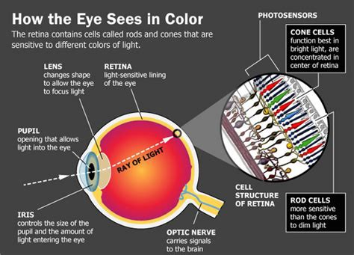
The human eye
Cones are a type of photoreceptor cell in the retina. They give us our color vision. Cones are concentrated in the center of our retina in an area called the macula and help us see fine details
Rods are a type of photoreceptor cell in the retina. They are sensitive to light levels and help give us good vision in low light. They are concentrated in the outer areas of the retina and give us peripheral vision. Rods are 500 to 1,000 times more sensitive to light than cones.
https://www.aao.org/eye-health/anatomy/rods#:~:text=Rods%20are%20a%20type%20of,sensitive%20to%20light%20than%20cones.
Image Source: https://medium.com/a-history-of-color/how-the-eye-percieves-color-93a3f10e03d9

Slide 4
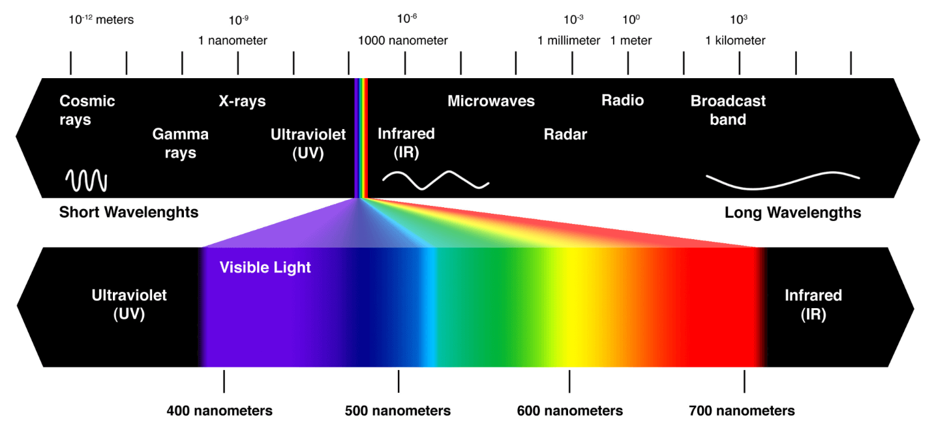
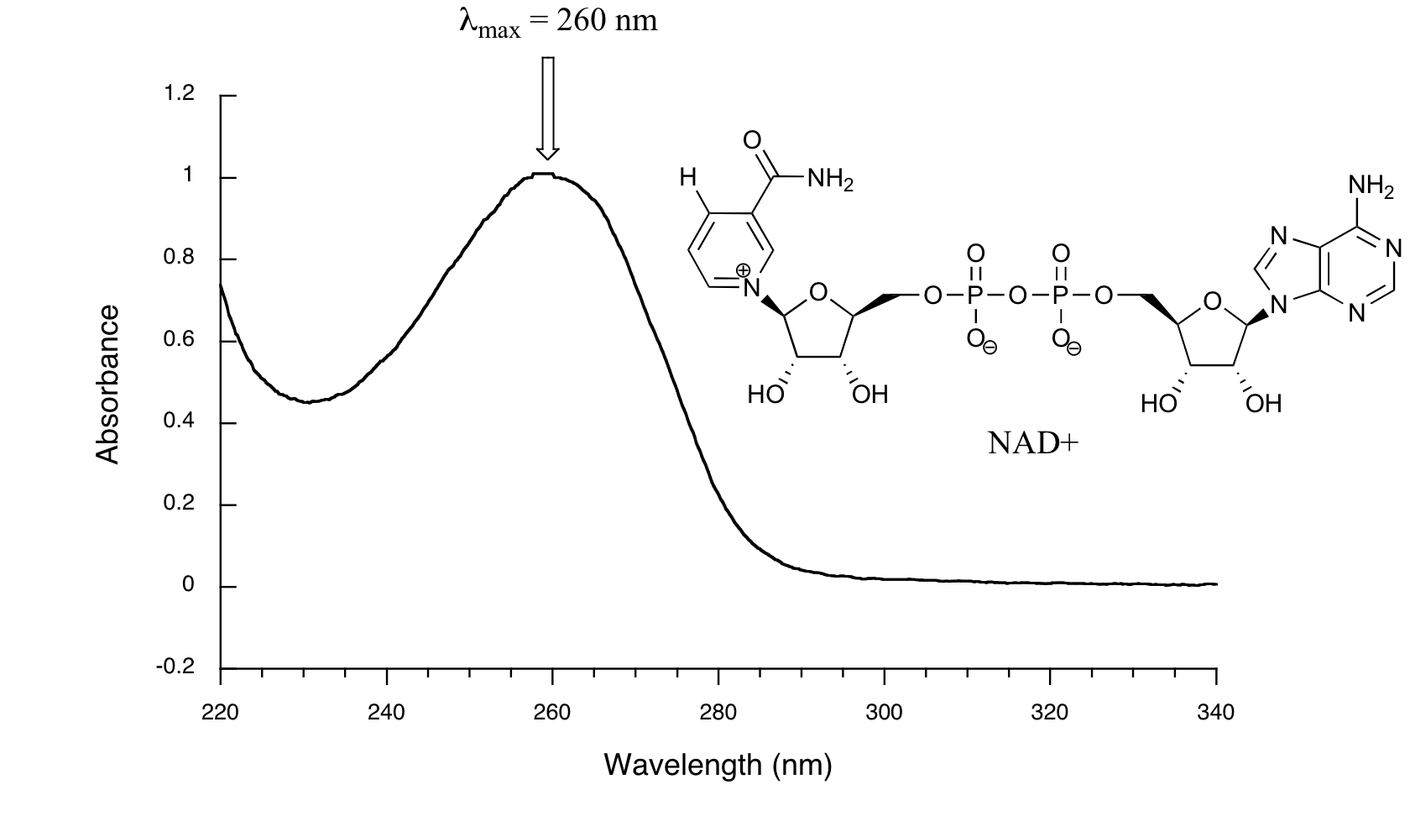

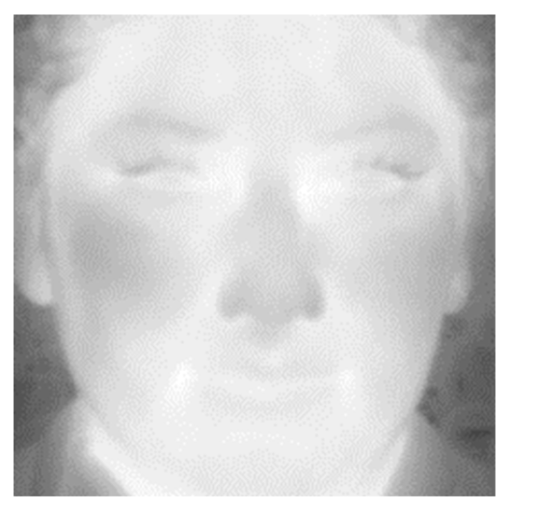
Light and colors
https://chem.libretexts.org/Bookshelves/Organic_Chemistry/Introduction_to_Organic_Spectroscopy/03%3A_Conjugated_Compounds_and_Ultraviolet_Spectroscopy/3.06%3A_Interpreting_Ultraviolet_Spectra
Image source: Kowalski, M.; Grudzień, A.; Mierzejewski, K. Thermal–Visible Face Recognition Based on CNN Features and Triple Triplet Configuration for On-the-Move Identity Verification. Sensors 2022, 22, 5012. https://doi.org/10.3390/s22135012
https://www.oncelighting.eu/visible-light-spectrum/

Slide 5
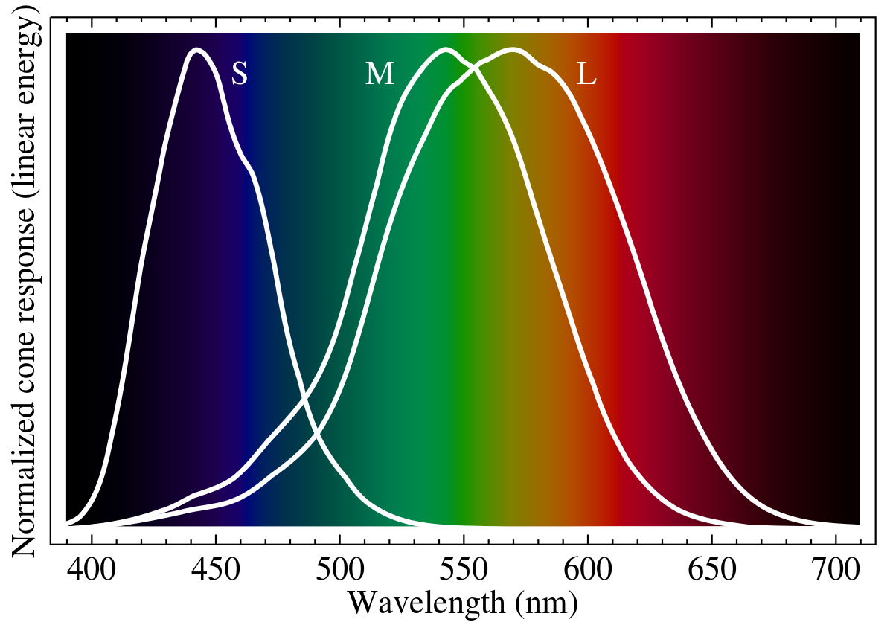
Human Eye
The normalized spectral sensitivity of human cone cells of short-, middle- and long-wavelength types.
The human eye with normal vision has three kinds of cone cells that sense light, having peaks of spectral sensitivity in short ("S", 420 nm – 440 nm), middle ("M", 530 nm – 540 nm), and long ("L", 560 nm – 580 nm) wavelengths
https://en.wikipedia.org/wiki/Cone_cell

Slide 6
Color Space and color model
A color space is a specific organization of colors.
A color space may be arbitrary, i.e. with physically realized colors assigned to a set of physical color swatches with corresponding assigned color names (including discrete numbers in – for example – the Pantone collection), or structured with mathematical rigor (as with the NCS System, Adobe RGB and sRGB)
A "color model" is an abstract mathematical model describing the way colors can be represented as tuples of numbers (e.g. triples in RGB or quadruples in CMYK)

Slide 7
An example: Pantone
The Pantone Color Matching System is largely a standardized color reproduction system, as of 2019 it has 2161 colors. By standardizing the colors, different manufacturers in different locations can all refer to the Pantone system to make sure colors match without direct contact with one another.
One such use is standardizing colors in the CMYK process. The CMYK process is a method of printing color by using four inks—cyan, magenta, yellow, and key (black) (However, about 30% of the Pantone system's 1114 spot colors (as of year 2000) cannot be simulated with CMYK but with 13 base pigments (14 including black) mixed in specified amounts, called base colors
https://en.wikipedia.org/wiki/Pantone

Slide 8
Tristimulus Values
Three parameters corresponding to levels of stimulus of the three kinds of cone cells, in principle describe any human color sensation.
these three values compose a tristimulus specification of the objective color of the light spectrum. The three parameters, denoted "S", "M", and "L", are indicated using a 3-dimensional space denominated the "LMS color space", which is one of many color spaces devised to quantify human color vision.

Slide 9
CIE 1931 color space (XYZ)
The CIE 1931 color spaces are the first defined quantitative links between distributions of wavelengths in the electromagnetic visible spectrum, and physiologically perceived colors in human color vision.
In the CIE 1931 model, Y is the luminance, Z is quasi-equal to blue (of CIE RGB), and X is a mix of the three CIE RGB curves chosen to be nonnegative (see § Definition of the CIE XYZ color space). Setting Y as luminance has the useful result that for any given Y value, the XZ plane will contain all possible chromaticities at that luminance.

Slide 10
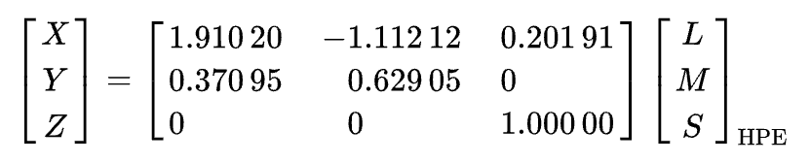
CIE 1931 color space (XYZ)
X,Y, Z values are obtained by various mathematical approximations from the response (modelled) of the human eye to a specific light.
Example of an approximation:

Slide 11
Chromaticity
Chromaticity is an objective specification of the quality of a color regardless of its luminance.
Chromaticity consists of two independent parameters, often specified as hue (h) and colorfulness (s), where the latter is alternatively called saturation, chroma, intensity,

Slide 12
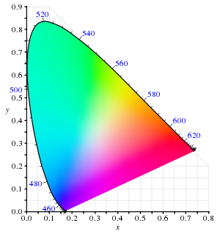
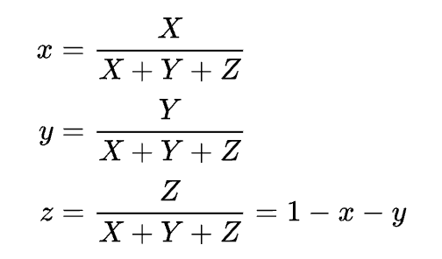
CIE xy chromaticity diagram
The CIE 1931 color space chromaticity diagram. The outer curved boundary is the spectral (or monochromatic) locus, with wavelengths shown in nanometers.
Note that the colors your screen displays in this image are specified using sRGB.

Slide 13
Chromaticity Diagram
What does this diagram represent? Let us consider all XYZ tristimulus values which have the same relative xyz values.
All these tristimulus values differ from each other only by a multiplicative coefficient and therefore represent colors that vary only by luminance.
It follows that all these colors have the same chromaticity. The diagram therefore represents the chromaticities and is therefore called the chromaticity diagram.
This diagram provides a map of all chromaticities, that is, of all colors except luminance.

Slide 14
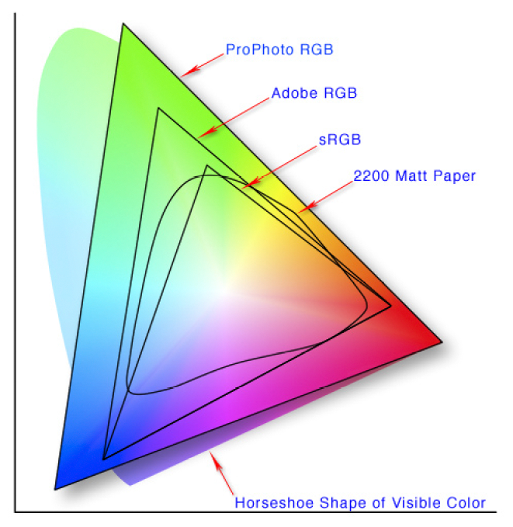
Different color spaces
https://en.wikipedia.org/wiki/Color_space

Slide 15
Color Depth
Color depth also known as bit depth, is either the number of bits used to indicate the color of a single pixel
When referring to a pixel, the concept can be defined as bits per pixel (bpp)
When referring to a color component, the concept can be defined as bits per component, bits per channel, bits per color (all three abbreviated bpc)

Slide 16
Color Gamut
In color reproduction, including computer graphics and photography, the gamut, or color gamut, is a certain complete subset of colors.
The most common usage refers to the subset of colors which can be accurately represented in a given circumstance, such as within a given color space or by a certain output device.

Slide 17
Example – CGA (Color Graphic Adapter)
16 kilobytes of video memory built in, and featured several graphics and text modes.
The highest display resolution of any mode was 640×200
highest color depth supported was 4-bit (16 colors)
The CGA card could be connected either to a direct-drive CRT monitor using a 4-bit digital (TTL) RGBI interface

Slide 18

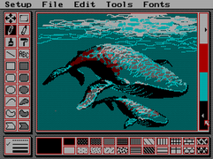
Example – CGA (Color Graphic Adapter)

Slide 19

VGA – Video Graphics Array
Standard graphics modes
640×480 in 16 colors or monochrome
640×350 or 640×200 in 16 colors or monochrome (EGA compatibility)
320×200 in 256 colors (Mode 13h)
320×200 in 4 or 16 colors (CGA compatibility)

Slide 20
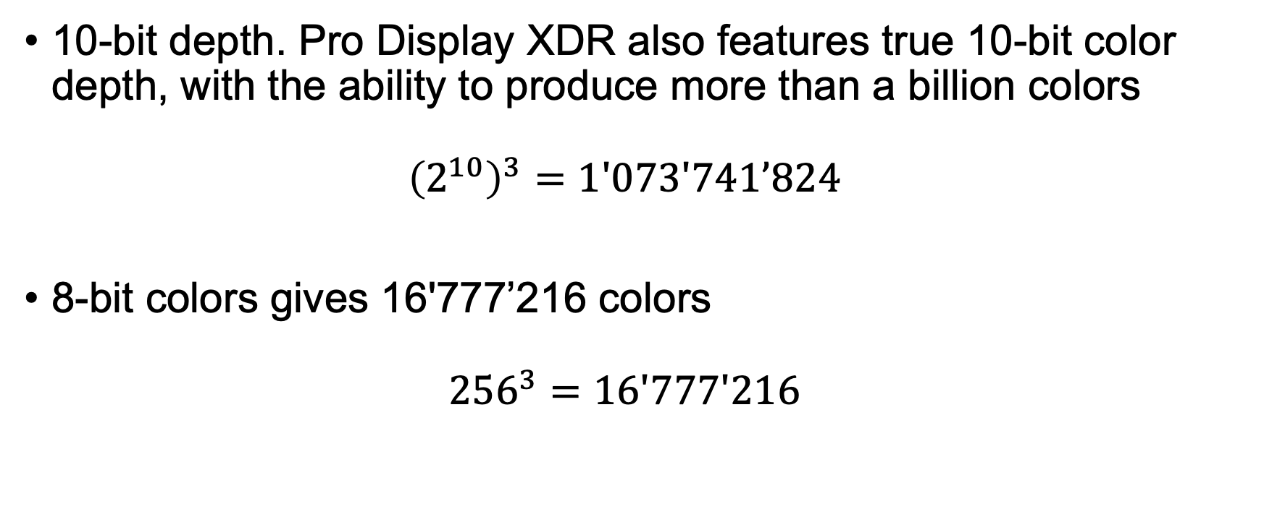
Modern Monitors color depth
10-bit depth. Pro Display XDR also features true 10-bit color depth, with the ability to produce more than a billion colors ${\left(2^{10}\right)}^{3}=1′073′741’824$
8-bit colors gives 16'777’216 colors ${256}^{3}=16′777′216$

Slide 21
Storage - Examples
A 24-bit uncompressed BMP, for instance, would take at least (24/8) * 3840 * 2160 bytes or about 24.9MB

Slide 22
Vision Ecosystem
Acquisition
Encoding
Storage
Visualisation
Printing

